Slide 1
Solid State Drive
BTS - Cloud Computing
Simon Max

Slide 2
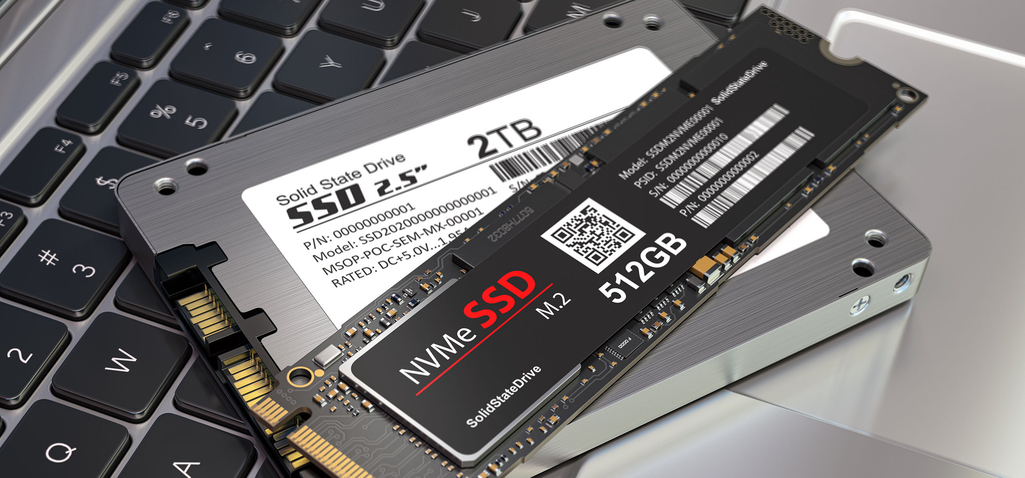
What is an SSD
Notes:
Storage Device

Slide 3
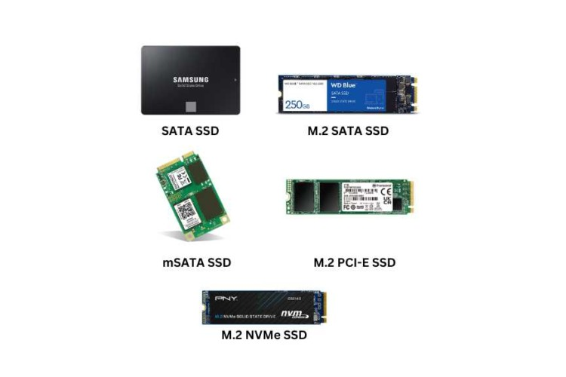
Most Used SSD
Sata
  read 500-560 MB/s
  write 450-520 MB/s
M.2 PCIe (3.0)
  read 2.500-3.500 MB/s
  write 1.500-3000 MB/s
M.2 NVMe SSD (4.0)
  read 5.000-7.500 MB/s
  write 4.000-7.000 MB/s
Notes:
AHCI (Advanced Host Controller Interface)

Slide 4
History
1970 – 1980
  Based on Ram chips
  Industry & Military
1990
  First Commercial SSD
  First NAND Flash-based SSD
  Capacity only ~ 100 MB
2000
  Capacity to 32-256GB
  Sata interface standardizes
  First time Laptop´s used SSD
2010
  SSD prices drop
  Sata III (500-600MB/s)
  MSATA and M.2 form factor
2015
  NVMe SSD over PCIe
  Higer capacity up to 61,44TB
Notes:
1970–1980 → nineteen seventy to nineteen eighty
1990 → nineteen ninety
256 → thirty-two to two hundred fifty-six

Slide 5
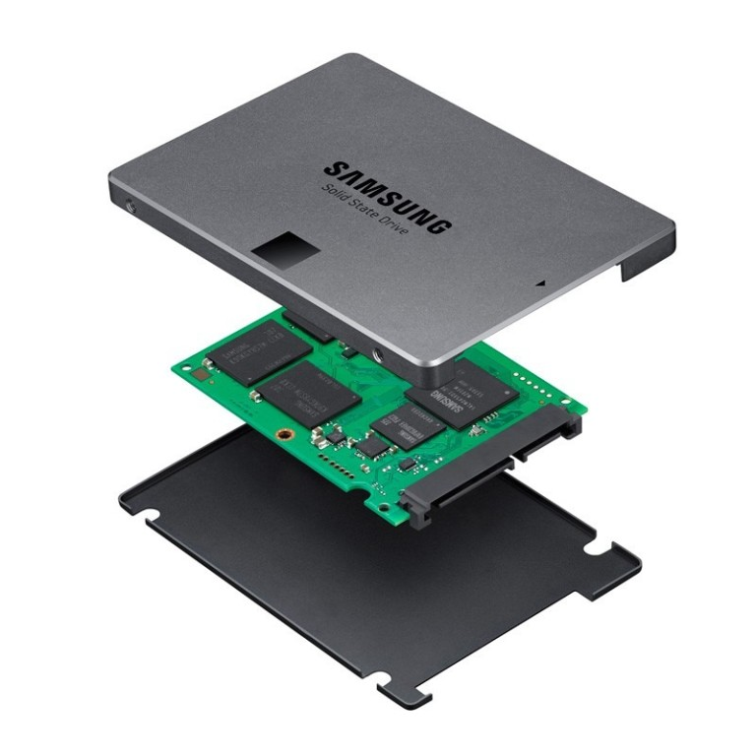
Inside an SSD

Slide 6
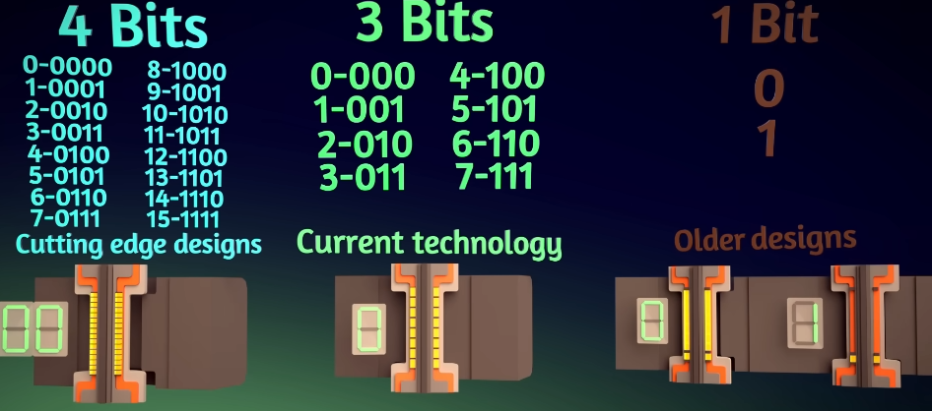
Charge Trap Flash memory cell
QLC- Quad Level Cell
TLC - Triple Level Cell
SLC - Single Level Cell
Notes:
15–25 nm range
Electrons
insulating layer that keeps the electrons stored

Slide 7
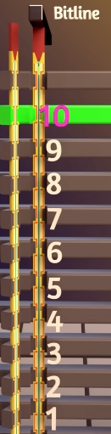
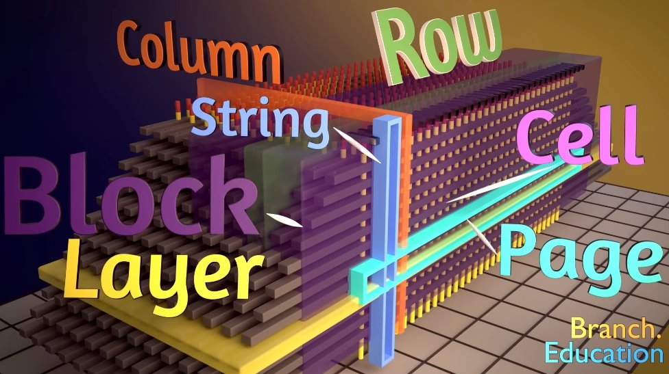
The Structure
<-- Control gates
3D-NAND
Notes:
are stacked vertically
Technical called V-NAND
Controle gates

Slide 8

Gates

Slide 9

Layers: 96-136
Wide: 30-60.000
Notes:
Manifactor don´t used 10 as in the examples but between ninety-six and one hundred thirty-six layers
3 time smaller than the paper

Slide 10
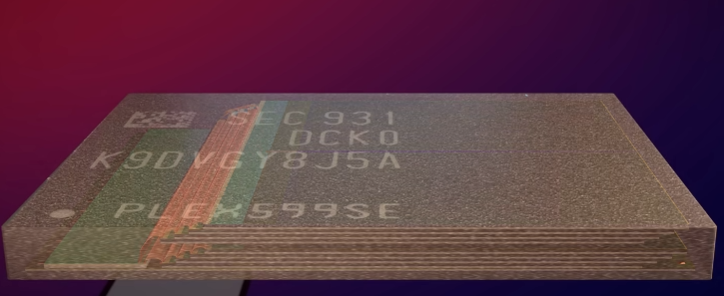
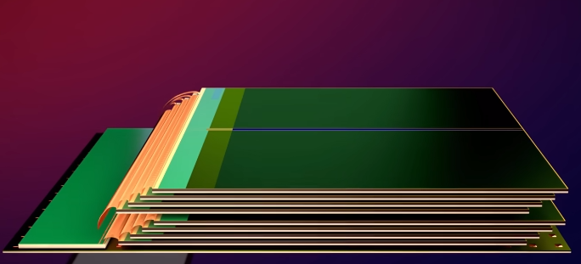
Chip
Notes:
We stack it eight times

Slide 11
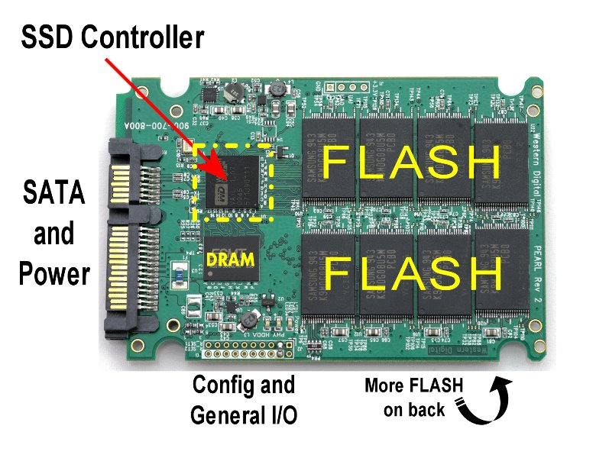
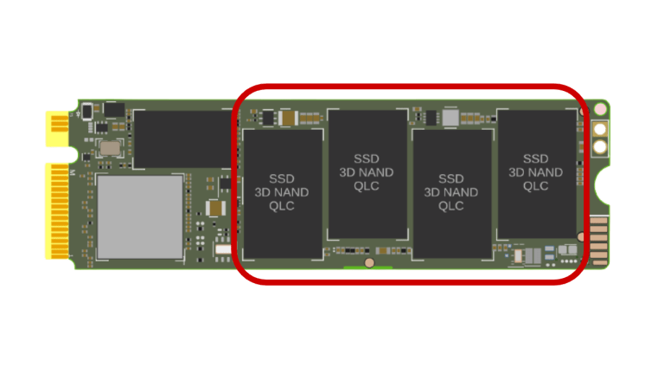
Controller & Cach
Wear-Leveling
S.M.A.R.T
Data
  Distribute
  Store
  Find
  Read
Notes:
to use every cell evenly

Slide 12
Durability / Lifespan of an SSD
When writing or deleting data, the insulating layer in the memory cells is slightly damaged each time. (~3,000 – 100,000)
If an SSD is not used for 10 years, it is usually no longer functional

Slide 13
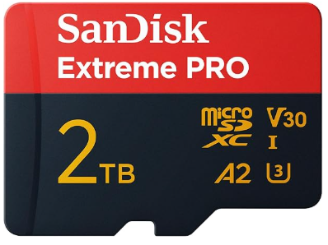
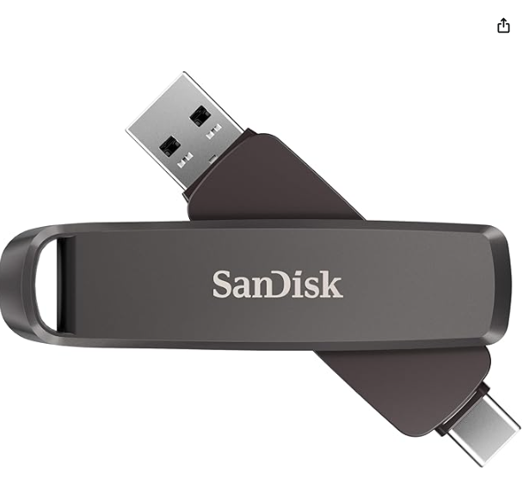
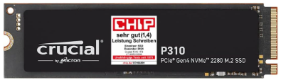
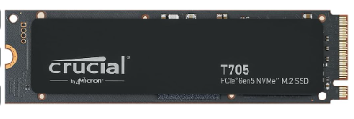








Micro SD Card
USB Stick
NVME Gen 4
NVME Gen 5

Slide 14
SSD VS HDD
SSD
HDD
Faster read/write
Durable
Uses less power
More expensive
Cheaper
Higher capacities
Cold Storage

Slide 15
When I used an SSD or an HDD
SSD
HDD
Operating System
Games
Documents (used)
NAS
Cloud Server
Backup (Photos & Documents)

Slide 16




Source
www.youtube.com/watch?v=5Mh3o886qpg&t
https://www.youtube.com/watch?v=a5aRz28q7ls
https://www.youtube.com/watch?v=E7Up7VuFd8A

